Slide 1
Exploratory Data Analysis
How to do EDA – Vamsi Krishna Sahini

Slide 2
EDA Content
Univariate Analysis
Bivariate Analysis
Correlation (Pearson and Cramer’s V)
Collinearity
KS Statistics
Frequency distributions and ECDF plots (cumulative distributions)
Box Plots
Joint Plots
Monotonicity
IV

Slide 4
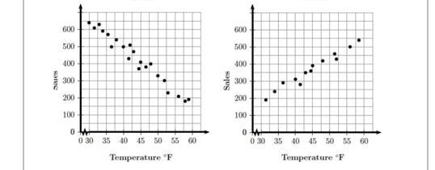
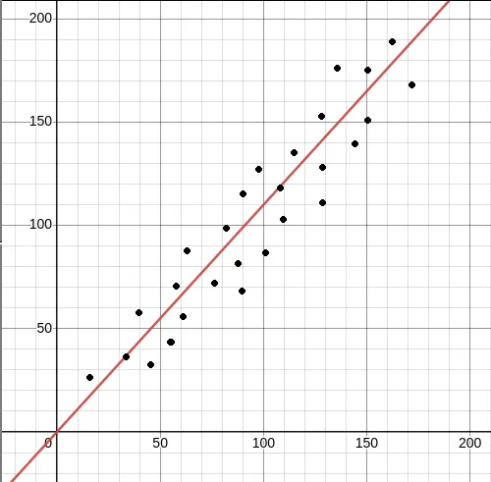
Linearity
The Dependent variable having Linear Relationship with Independent Variable
Homoscedasticity
variance of the residuals is consistent across all values of independent variables
The Breush – Pegan Test

